Slide 1

Einleitung
.NET und C# Tuning und Troubleshooting
Rainer Stropek
software architects gmbh
Web
Mail
Twitter
http://www.timecockpit.com
rainer@timecockpit.com
@rstropek
Begrüßung und Agenda

Slide 2
Agenda (German)
Die Software ist fertig, Kunden beschweren sich aber über schlechte Performance. Was nun? In seinem Vortrag spricht Rainer Stropek über Strategien, wie man die Performance von C#-Code strukturiert verbessern kann. Er erklärt, wie man ein Optimierungsprojekt gut vorbereitet und welche Fallen dem Erfolg im Weg stehen. Im Praxisteil zeigt Rainer verschiedene Tools anhand von Programmbeispielen. Sie sehen unter anderen Visual Studio Profiler, Visual Studio Load Testing, PerfView und den Performance Profiler von Red Gate.

Slide 3
Why Optimizing? Examples …
Customer satisfaction
Customers report performance problems
Reduce churn rate
Tip: Ask you users if they are leaving because of poor performance
Raise conversion rate
Consider the first impression potential users have from your software
Tip: Ask your users why they are not buying
Reduce TCO of your application
Performance problems waste your user’s time = money
Reduce TCO for your customers by lowering system requirements
Cloud environment is too expensive

Slide 4
Anti-Patterns
How to ruin every optimization project

Slide 5
Optimization Anti-Patterns
Add optimizations during initial development
Aka “premature optimization”
Write obvious (not naïve) code first → measure → optimize if necessary
Perf problems will always be where you don’t expect them
Optimize code without measuring
Without measuring, optimized code is often slower
Make sure to know if your optimization brought you closer to your goals
Optimize for non-representative environments
Specify problematic environments as accurate as possible
Test your application on systems similar to your customers’ environments
Hardware, software, test data (consider data security)

Slide 6
Optimization Anti-Patterns
Optimization projects without concrete goals
Add perf goals (quantifiable) in requirements
You could spend endless time optimizing your applications
Optimize to solve concrete problems (e.g. for memory, for throughput, for response time)
Soft problems or goals
Strive for quantifiable perf metrics in problem statements and goals
Objective perf problems instead of subjective stories
Optimize without a performance baseline
Always know your performance baseline and compare against it
Reproducible test scenarios are important

Slide 7
Optimization Anti-Patterns
Optimize without profound knowledge about your platform
Know your runtime, platform, hardware, and tools
Optimize the wrong places
E.g. optimize C# code when you have a DB-related problem
Spend enough time on root-cause analysis for your perf problems
Ship debug builds
Release builds are much faster than debug builds

Slide 8
Optimization Anti-Patterns
Optimize everything
Focus on performance-critical aspects of your application instead
Pareto principle (80/20)
Architect without performance in mind
Avoid architecture with inherent performance problems
If necessary, consider prototyping in early project stages
Confuse performance and user experience
Async programming might not be faster but delivers better user experience
Ignore Telemetry
Real-world performance data (especially in SaaS-scenarios)

Slide 9
Optimization Projects
Prepare optimization projects for success

Slide 10
Good Optimization Projects
1. Plan for it
Put it on your backlog
Get (time) budget for it (time-boxing); consider business case for your optimization project
Follow Design-to-Cost approach
Make yourself familiar with corresponding tools
2. Prepare a defined, reproducible test scenario
Hardware, software, network
Test data (e.g. database)
Application scenarios (automate if possible)
3. Measure performance baseline
E.g. CPU%, memory footprint, throughput, response time

Slide 11
Good Optimization Projects
4. Define performance goals
Must be measurable
Involve stakeholders (e.g. product owners, customers, partners, etc.)
5. Optimize – Measure – Analyze Cycle
Don’t change too many things at the same time
Measure after optimizing
Compare against baseline; if necessary, reset your baseline
Check if you have reached performance goals/time-box
6. Ask for feedback in real-world environments
E.g. friendly customers, testing team
Telemetry (e.g. Application Insights)

Slide 12
Good Optimization Projects
7. Document and present your work
Architecture, code, measurement results
Potentially change your system requirements, guidelines for admins, etc.
Share best/worst practices with your peers
8. Ship your results
Remember: Ship release builds
Continuous deployment/short release cycles let customers benefit from perf optimizations
Consider hotfixes

Slide 13
Use the Cloud
Easy to build different execution environments
Number of processors, RAM, different operating systems, etc.
Performance of database clusters
Don’t wait for admins to setup/deliver test machines/VMs
Design for scale-out and micro-services
Easier to add/remove VMs/containers than scaling up/down
Use micro-services and use e.g. Azure Websites or Docker to map to server farms
Extremely cost efficient
You only pay for the time your perf tests last
You can use your partner benefits, BizSpark benefits, etc.

Slide 14
Use the Cloud
Less data security issues if you use artificial test data
Ability to run large-scale load tests
Gather perf data during long-running, large-scale load tests
SaaS enables you to optimize for a concrete environment
Economy of scale

Slide 15
Perf Influencers
What influences the performance of your applications?

Slide 16
Performance influencers
Performance of storage system
Database, file system, etc.
Performance of services used
E.g. external web services
Network characteristics
How chatty is your application?
Latency, throughput, bandwidth
Especially important in multi-tier applications

Slide 17
Performance influencers
Efficiency of your algorithms
Core algorithms
Parallel vs. sequential
Platform characteristics
JIT compiler
Garbage collector
Hardware
Number of cores, 64 vs. 32 bits, RAM, SSDs, etc.

Slide 18
Database
DB performance considerations

Slide 19
Influencers
Network connection to the database
Latency, throughput
Do you really need all the data you read from the database (e.g. unnecessary columns)?
Generation of execution plan
Statement parsing, compilation of execution plan
Bound to CPU-power of database server
Can’t you simplify your query to speed up parse and compile time?
Query execution
Complexity of query, index optimization, etc.
You might need a database expert/admin to tune your SQL statements

Slide 20
Influencers
Process DB results
Turn DB results into .NET objects (O/R mappers)
DB access characteristics
Many small vs. few large statements
Lazy loading
DB latency influences DB access strategy

Slide 21
Finding problematic queries
SQL Server Profiler
Create and manage traces, replay trace results
Will pre deprecated
SQL Server Extended Events
Collect information to troubleshoot or identify performance problems
Dynamic Management Views (DMV)
sys.dm_exec_query_stats
sys.dm_exec_cached_plans
Monitoring Azure SQL Database Using DMVs

Slide 22
Finding problematic queries
SQL Server Query Store (SQL 2016, Azure SQL DB)
Query history incl. execution plans
Get insights into query plans and performance

Slide 23
DMVs
SELECT TOP 10 query_stats.query_hash AS "Query Hash",
SUM(query_stats.execution_count) AS "Execution Count",
MAX(query_stats.total_worker_time) AS "Max CPU Time",
MIN(query_stats.statement_text) AS "Statement Text"
FROM
(SELECT QS.*, SUBSTRING(ST.text, (QS.statement_start_offset/2) + 1,
((CASE statement_end_offset WHEN -1
THEN DATALENGTH(st.text)
ELSE QS.statement_end_offset END
- QS.statement_start_offset)/2) + 1) AS statement_text
FROM sys.dm_exec_query_stats AS QS
CROSS APPLY sys.dm_exec_sql_text(QS.sql_handle) as ST)
as query_stats
GROUP BY query_stats.query_hash
ORDER BY 3 DESC;
GO
Find long running queries in Azure
See also https://msdn.microsoft.com/en-us/library/azure/ff394114.aspx

Slide 24
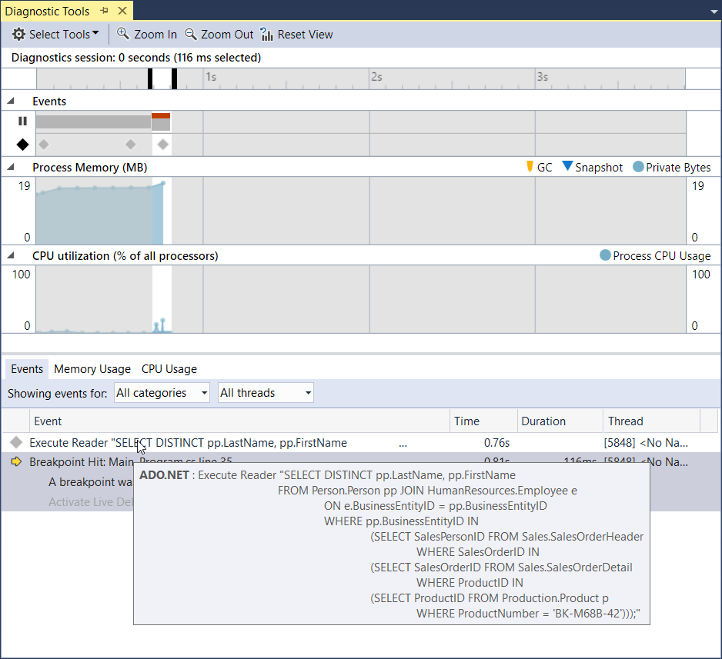
Finding problematic queries
Diagnostic Tools in Visual Studio 2015

Slide 25
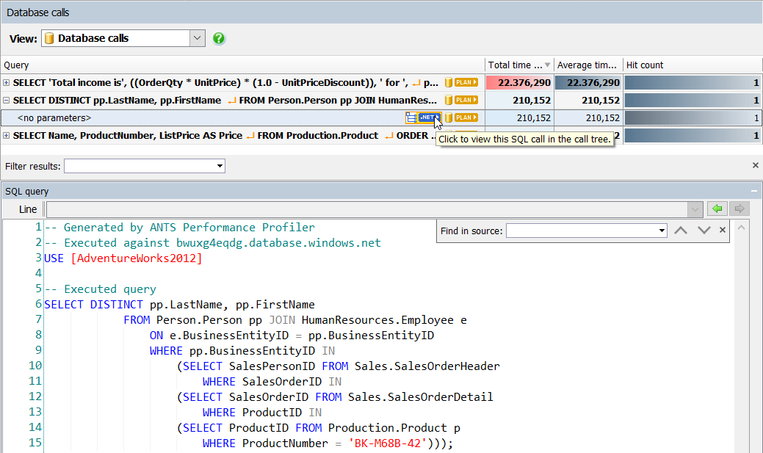
Finding problematic queries
ANTS Performance Profiler

Slide 26
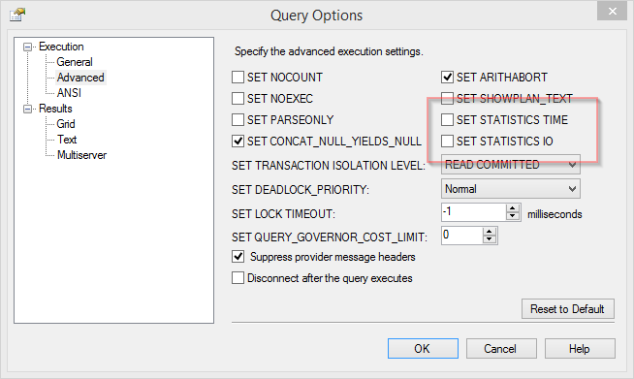
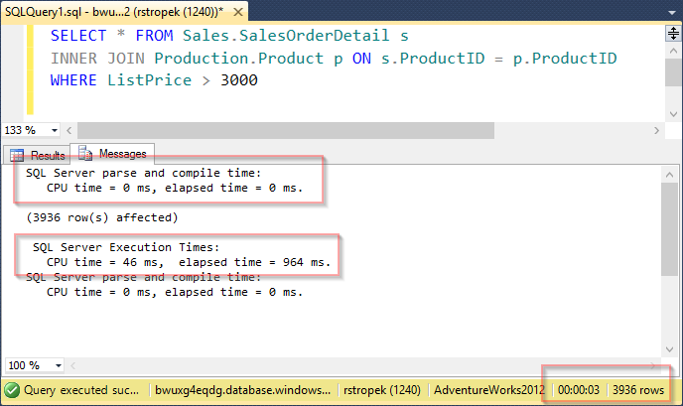
Client Statistics
Query analysis

Slide 27
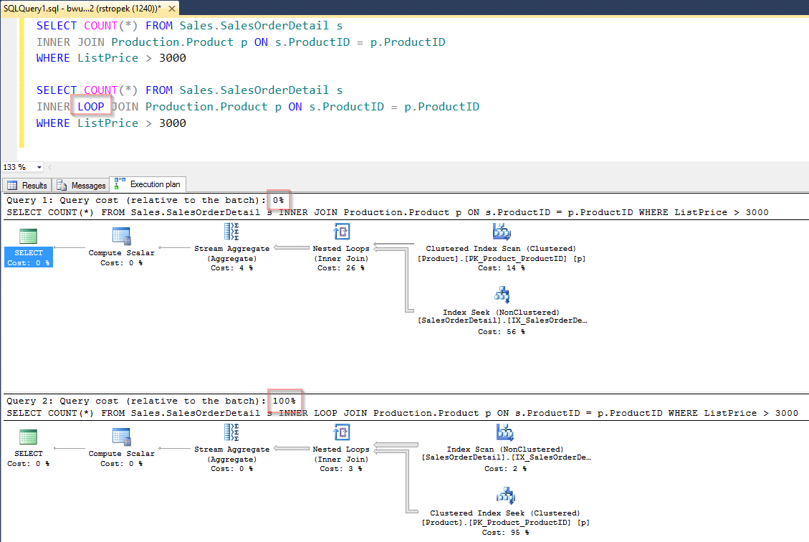
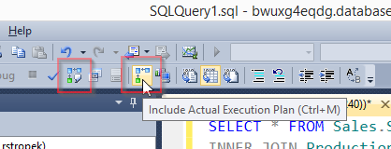
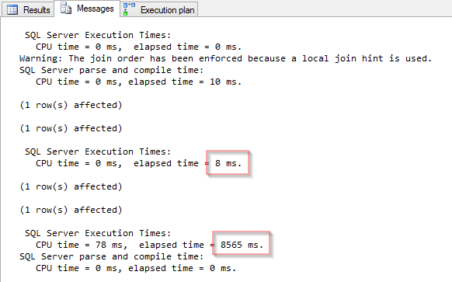
Execution Plans
Query analysis

Slide 28
Services, Network

Slide 29
Things to Consider
How often do you call over the network?
Latency, speed-of-light problem
Ratio between latency and service operation
Consider reducing network calls with caching (e.g. Redis cache) …
… but make sure that you cache doesn’t make perf worse!
How much data do you transfer?
Transfer less data (e.g. unnecessary database columns)
Make protocol more efficient (e.g. specific REST services or OData instead of generic services)
Measuring is important
The tools you use might do things you are not aware of (e.g. OR-mapper)

Slide 30
Tools
Telerik Fiddler
Web debugging proxy
Wireshark
Network packet analyzer

Slide 31
Just in Time Compiler
Influencing startup time through the JITer

Slide 32
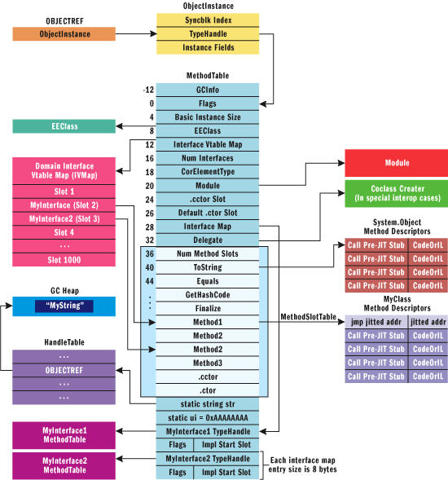
JIT Compiler
Just in Time Compiler
PreJITStub responsible for triggering JIT
Overwritten with a jump to JIT compiled code
Image Source: https://msdn.microsoft.com/en-us/magazine/cc163791.aspx

Slide 33
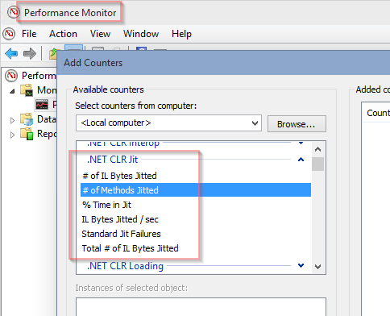
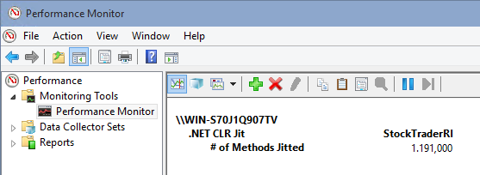
PerfMon
Collect JIT data with PerfMon

Slide 34
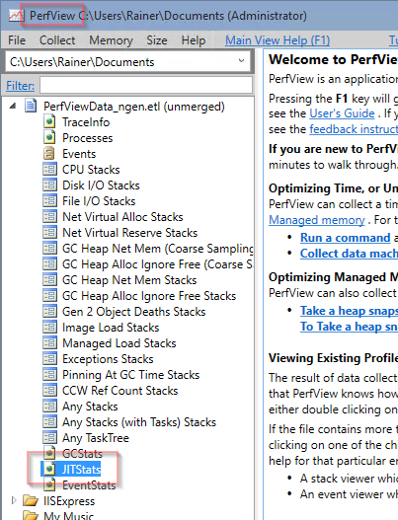
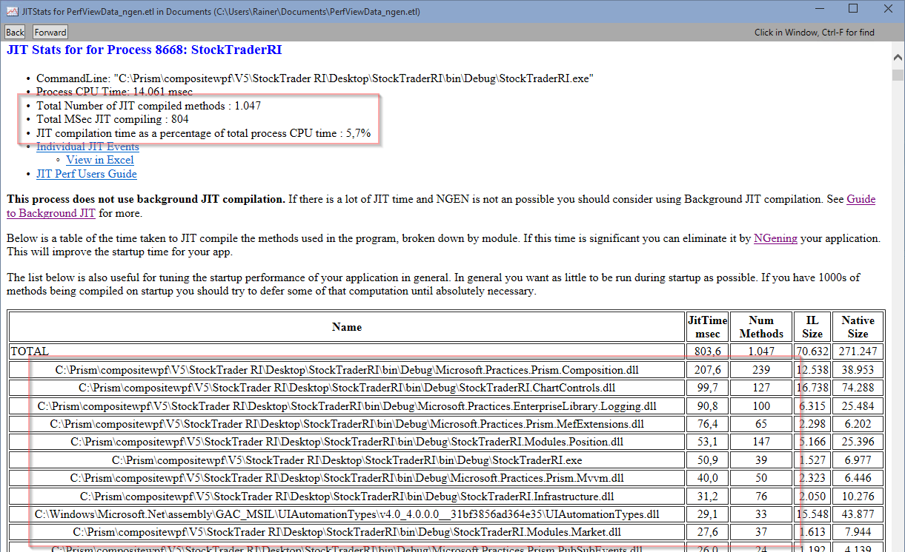
JIT Analysis
PerfView

Slide 35
NGEN – Native Image Generator
Generates native images for assembly and dependencies
Reference counting
Advantages
Better startup time (no JITing, faster assembly loading)
Smaller memory footprint (code sharing between processes, important in RDS scenarios)
Disadvantages
NGEN has to be called (also for updates) – requires installer (incl. admin privileges)
NGEN takes time (longer install time)
NGEN images are larger on disk
Native code slightly less performant than JIT’ed code

Slide 36
NGEN
# Display NGEN’ed images
ngen display
# Install assembly
ngen install StockTraderRI.exe
# Uninstall assembly
ngen uninstall StockTraderRI.exe
Ahead-of-time Compilation
Note that it is important to use the correct version of NGEN
64bit: c:\Windows\Microsoft.NET\Framework64\v4.0.30319\
32bit: C:\Windows\Microsoft.NET\Framework\v4.0.30319\

Slide 37
NGEN
c:\Windows\Microsoft.NET\Framework64\v4.0.30319\ngen install StockTraderRI.exe
c:\Windows\Microsoft.NET\Framework64\v4.0.30319\ngen install Microsoft.Practices.EnterpriseLibrary.Common.dll
c:\Windows\Microsoft.NET\Framework64\v4.0.30319\ngen install Microsoft.Practices.EnterpriseLibrary.ExceptionHandling.dll
c:\Windows\Microsoft.NET\Framework64\v4.0.30319\ngen install Microsoft.Practices.EnterpriseLibrary.Logging.dll
c:\Windows\Microsoft.NET\Framework64\v4.0.30319\ngen install Microsoft.Practices.Prism.Composition.dll
c:\Windows\Microsoft.NET\Framework64\v4.0.30319\ngen install Microsoft.Practices.Prism.Interactivity.dll
c:\Windows\Microsoft.NET\Framework64\v4.0.30319\ngen install Microsoft.Practices.Prism.MefExtensions.dll
c:\Windows\Microsoft.NET\Framework64\v4.0.30319\ngen install Microsoft.Practices.Prism.Mvvm.Desktop.dll
c:\Windows\Microsoft.NET\Framework64\v4.0.30319\ngen install Microsoft.Practices.Prism.Mvvm.dll
c:\Windows\Microsoft.NET\Framework64\v4.0.30319\ngen install Microsoft.Practices.Prism.PubSubEvents.dll
c:\Windows\Microsoft.NET\Framework64\v4.0.30319\ngen install Microsoft.Practices.Prism.SharedInterfaces.dll
c:\Windows\Microsoft.NET\Framework64\v4.0.30319\ngen install Microsoft.Practices.ServiceLocation.dll
c:\Windows\Microsoft.NET\Framework64\v4.0.30319\ngen install StockTraderRI.ChartControls.dll
c:\Windows\Microsoft.NET\Framework64\v4.0.30319\ngen install StockTraderRI.Infrastructure.dll
c:\Windows\Microsoft.NET\Framework64\v4.0.30319\ngen install StockTraderRI.Modules.Market.dll
c:\Windows\Microsoft.NET\Framework64\v4.0.30319\ngen install StockTraderRI.Modules.News.dll
c:\Windows\Microsoft.NET\Framework64\v4.0.30319\ngen install StockTraderRI.Modules.Position.dll
c:\Windows\Microsoft.NET\Framework64\v4.0.30319\ngen install StockTraderRI.Modules.Watch.dll
c:\Windows\Microsoft.NET\Framework64\v4.0.30319\ngen uninstall StockTraderRI.exe
c:\Windows\Microsoft.NET\Framework64\v4.0.30319\ngen uninstall Microsoft.Practices.EnterpriseLibrary.Common.dll
c:\Windows\Microsoft.NET\Framework64\v4.0.30319\ngen uninstall Microsoft.Practices.EnterpriseLibrary.ExceptionHandling.dll
c:\Windows\Microsoft.NET\Framework64\v4.0.30319\ngen uninstall Microsoft.Practices.EnterpriseLibrary.Logging.dll
c:\Windows\Microsoft.NET\Framework64\v4.0.30319\ngen uninstall Microsoft.Practices.Prism.Composition.dll
c:\Windows\Microsoft.NET\Framework64\v4.0.30319\ngen uninstall Microsoft.Practices.Prism.Interactivity.dll
c:\Windows\Microsoft.NET\Framework64\v4.0.30319\ngen uninstall Microsoft.Practices.Prism.MefExtensions.dll
c:\Windows\Microsoft.NET\Framework64\v4.0.30319\ngen uninstall Microsoft.Practices.Prism.Mvvm.Desktop.dll
c:\Windows\Microsoft.NET\Framework64\v4.0.30319\ngen uninstall Microsoft.Practices.Prism.Mvvm.dll
c:\Windows\Microsoft.NET\Framework64\v4.0.30319\ngen uninstall Microsoft.Practices.Prism.PubSubEvents.dll
c:\Windows\Microsoft.NET\Framework64\v4.0.30319\ngen uninstall Microsoft.Practices.Prism.SharedInterfaces.dll
c:\Windows\Microsoft.NET\Framework64\v4.0.30319\ngen uninstall Microsoft.Practices.ServiceLocation.dll
c:\Windows\Microsoft.NET\Framework64\v4.0.30319\ngen uninstall StockTraderRI.ChartControls.dll
c:\Windows\Microsoft.NET\Framework64\v4.0.30319\ngen uninstall StockTraderRI.Infrastructure.dll
c:\Windows\Microsoft.NET\Framework64\v4.0.30319\ngen uninstall StockTraderRI.Modules.Market.dll
c:\Windows\Microsoft.NET\Framework64\v4.0.30319\ngen uninstall StockTraderRI.Modules.News.dll
c:\Windows\Microsoft.NET\Framework64\v4.0.30319\ngen uninstall StockTraderRI.Modules.Position.dll
c:\Windows\Microsoft.NET\Framework64\v4.0.30319\ngen uninstall StockTraderRI.Modules.Watch.dll
Sample Script (Hidden Slide)

Slide 38
NGEN/JIT Tips
WiX installer framework supports NGEN’ing
How To: NGen Managed Assemblies During Installation
Further optimization with MPGO (.NET 4.5)
Managed Profile Guided Optimization Tool
Generate profile data consumed by NGEN to optimize native images (disk layout)
Opt-in to background JIT (.NET 4.5)
Use System.Runtime.ProfileOptimization class

Slide 39
Garbage Collector
How memory management influences performance

Slide 40
CLR Memory Management
CLR is a stack-based runtime
Value types
Managed heap
Managed by the CLR
Allocating memory is usually very fast
When necessary (e.g. thresholds, memory pressure, etc.), unreferenced memory is freed
Generations of objects
Gen 0, 1, and 2
Large objects (>85k bytes) are handled differently (large object heap)

Slide 41
CLR Memory Management
Different GC strategies
Workstation (background) garbage collection
Server garbage collection (optimized for throughput)
Choose via config setting
Concurrent collection for Gen 2 collections
You can allocate small objects during Gen 2 collection
Background GC
For workstation in .NET >= 4, for server in .NET >= 4.5
For details see MSDN

Slide 42
Memory Management Tips
Avoid allocating unnecessary memory
This would raise GC pressure
Consider weak references for large objects
Reuse large objects
Use memory perf counters for analysis
See MSDN for details
Be careful when inducing GC with GC.Collect
Add GC.Collect only if you are sure that it makes sense

Slide 43
Memory Management Tips
Hunt memory leaks and remove them
See my memory leak hunting challenge on Codeproject
Suppress GC during perf critical operations
Use GC latency modes for that
Use this feature with care

Slide 44
Summary
Prepare your optimization projects appropriately
Write obvious code first
Measure to find the right places to optimize
Use profilers
Make small steps and gather feedback
Use the cloud

Slide 45
Q&A
.NET und C# Tuning und Troubleshooting
Rainer Stropek
software architects gmbh
Mail Web Twitter
rainer@timecockpit.com http://www.timecockpit.com @rstropek
Thank your for coming!

